Slide 2
F5 Agility 2018 Lab: iRules - Security
Speaker name, Job Title

Slide 3
Why use iRules for security?

Slide 4
81
each week
4,066
4,262
3,986
In 2017 we saw roughly 81 new 0-day vulnerabilities each week
2015
2016
2017
Symantec 2018 Internet Security Threat Report

Slide 5
9
hours
Every 9 hours a critical CVE was published in 2017
Data Source: F5 Labs

Slide 6
“A significantly large number of security teams are performing little in the way of formal application protection tools/techniques.
In surveys performed for the latest F5labs Application Protection Report, only 36% of respondents say they implement application hardening practices before deploying an application ‘most of the time’.”
- F5Labs

Slide 7
iRules are a great way to
fix things
that are hard to solve in the application stack.

Slide 8
F5’s full proxy architecture is a strategic point of control
for layers 3 to 7 traffic.
Independent
proxy-level control
Independent
proxy-level control
Availability
Performance
Security

Slide 9
Security iRule Solutions in today’s lab
TLS Version Control
F5 ASM Hooks
HTTP Throttling
Content Rewrite
HSTS/HPKP
F5 DNS Hooks
Geolocation + L7DoS Hooks
Securing Cookies
All of today’s solutions are presented as a sequence of scenario’s, then solved according to business requirements with an iRule!
©
9

Slide 10

Lab Logistics
Time
Laptop
Enthusiasm
4 short hours
Required for labs
Because knowing how to use iRules for security will make you popular
© 2017 F5 Networks
10

Slide 11
http://training.f5agility.com
Class #: 201

Slide 12

Lab environment
Ravello Cloud Environment
Ubuntu Desktop
Services
RDP
You
BIG-IP VE
Services
Services

Slide 13
TLS Version Control

Slide 14
Connections by TLS version
when CLIENTSSL_HANDSHAKE { ISTATS::incr "ltm.virtual [virtual name] c [SSL::cipher version]" 1 }
[user@murky:Active] ~ # tmsh show ltm virtual stdsslvip
------------------------------------------------------------------
Ltm::Virtual Server: stdsslvip
------------------------------------------------------------------
Status
Availability : available
State : enabled
Reason : The virtual server is available
CMP : enabled
CMP Mode : all-cpus
Destination : 192.168.2.189:443
Traffic ClientSide Ephemeral General
Bits In 872.0K 0 -
Bits Out 3.7M 0 -
Packets In 943 0 -
Packets Out 871 0 -
User-defined Value
SSLv3 21
TLSv1 32
TLSv1.1 54
TLSv1.2 282

Slide 15
TLS version inspection
If the TLS version is less than 1.1, send the user to a “safe” page:
when CLIENTSSL_HANDSHAKE {
if { [SSL::cipher version] equals "TLSV1" or [SSL::cipher version] equals "SSLv3" } {
set redirect "http://www.f5test.local/insecure.html"
SSL::respond "HTTP/1.1 302 Found\r\nLocation: $redirect\r\n\r\n"
}
}

Slide 16
ASM Hooks

Slide 17
F5 ASM Hooks
when ASM_REQUEST_DONE {
# triggered after ASM has finished processing the request and found all violations of the ASM policy.
if { [ASM::status] equals "blocked" } {
# Returns the status of the request after ASM processing
#ASM::violation returns list of violations found in request/response together, further refined with below command options
log local0. "Violation count: [ASM::violation count] "
log local0. "Violation names: [ASM::violation names] "
log local0. "Violation attack types: [ASM::violation attack_types] "
log local0. "Violation details: [ASM::violation details] "
if { [ASM::violation count] <= 1 } {
if { [lindex [ASM::violation names] 0] equals "VIOLATION_HTTP_SANITY_CHECK_FAILED" } {
# ASM::client_ip returns client IP from ASM’s perspective (e.g XFF, Alt-XFF)
if { [ASM::client_ip] equals "10.1.10.51" } {
# Unblocks the request, but will still log/report the violation
ASM::unblock
}
}
}
}
}

Slide 18
F5 ASM Hooks
when ASM_REQUEST_DONE {
# triggered after ASM has finished processing the request and found all violations of the ASM policy.
if { [ASM::status] equals "blocked" } {
# Returns the status of the request after ASM processing
#ASM::violation returns list of violations found in request/response together, further refined with below command options
log local0. "Violation count: [ASM::violation count] "
log local0. "Violation names: [ASM::violation names] "
log local0. "Violation attack types: [ASM::violation attack_types] "
log local0. "Violation details: [ASM::violation details] "
if { [ASM::violation count] <= 1 } {
if { [lindex [ASM::violation names] 0] equals "VIOLATION_HTTP_SANITY_CHECK_FAILED" } {
# ASM::client_ip returns client IP from ASM’s perspective (e.g XFF, Alt-XFF)
if { [ASM::client_ip] equals "10.1.10.51" } {
# Unblocks the request, but will still log/report the violation
ASM::unblock
}
}
}
}
}

Slide 19
F5 ASM Hooks
when ASM_REQUEST_DONE {
# triggered after ASM has finished processing the request and found all violations of the ASM policy.
if { [ASM::status] equals "blocked" } {
# Returns the status of the request after ASM processing
#ASM::violation returns list of violations found in request/response together, further refined with below command options
log local0. "Violation count: [ASM::violation count] "
log local0. "Violation names: [ASM::violation names] "
log local0. "Violation attack types: [ASM::violation attack_types] "
log local0. "Violation details: [ASM::violation details] "
if { [ASM::violation count] <= 1 } {
if { [lindex [ASM::violation names] 0] equals "VIOLATION_HTTP_SANITY_CHECK_FAILED" } {
# ASM::client_ip returns client IP from ASM’s perspective (e.g XFF, Alt-XFF)
if { [ASM::client_ip] equals "10.1.10.51" } {
# Unblocks the request, but will still log/report the violation
ASM::unblock
}
}
}
}
}

Slide 20
F5 ASM Hooks
when ASM_REQUEST_DONE {
# triggered after ASM has finished processing the request and found all violations of the ASM policy.
if { [ASM::status] equals "blocked" } {
# Returns the status of the request after ASM processing
#ASM::violation returns list of violations found in request/response together, further refined with below command options
log local0. "Violation count: [ASM::violation count] "
log local0. "Violation names: [ASM::violation names] "
log local0. "Violation attack types: [ASM::violation attack_types] "
log local0. "Violation details: [ASM::violation details] "
if { [ASM::violation count] <= 1 } {
if { [lindex [ASM::violation names] 0] equals "VIOLATION_HTTP_SANITY_CHECK_FAILED" } {
# ASM::client_ip returns client IP from ASM’s perspective (e.g XFF, Alt-XFF)
if { [ASM::client_ip] equals "10.1.10.51" } {
# Unblocks the request, but will still log/report the violation
ASM::unblock
}
}
}
}
}

Slide 21
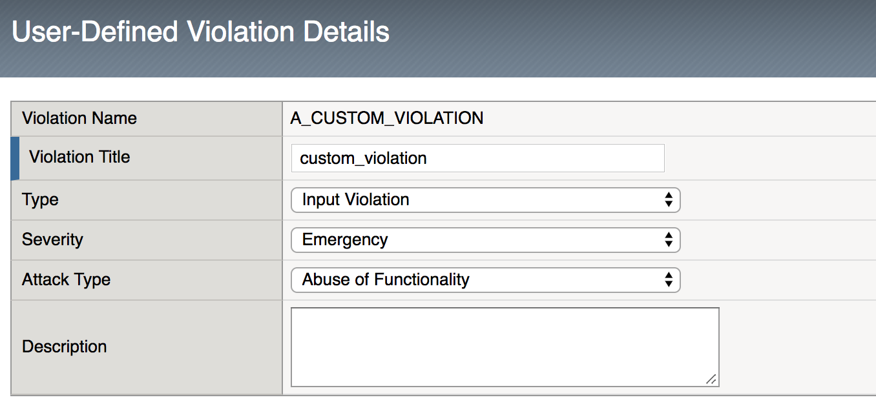
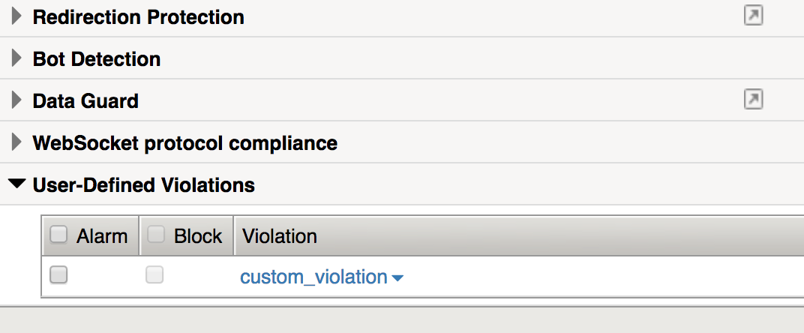
F5 ASM hooks
Not part of today’s lab scenario, but equally interesting and useful ...
When ASM_REQUEST_DONE {
if {$something_bad_happened } {
set viol_data []
set relevant_data []
set more_relevant_data []
# Below lines add data and context to the custom violation we are going “raise”
lappend relevant_data ”User data collected in iRule” $user_data
lappend more_relevant_data ”Count of bad things user tried to do " $bad_count
lappend viol_data $relevant_data $more_relevant_data
# Raise the violation, and handle according to learning and blocking settings in ASM Policy.
# Appending the context collected above.
ASM::raise A_CUSTOM_VIOLATION $viol_data
}
}

Slide 22
HTTP Throttling

Slide 23
HTTP throttling
when RULE_INIT {
set static::maxReqs 5;
set static::timeout 30;
}
when HTTP_REQUEST {
if { [class match [HTTP::method] equals “POST”] } {
if { [HTTP::header exists X-forwarded-for] } {
set client_IP_addr [getfield [lindex [HTTP::header values X-Forwarded-For] 0] "," 1]
} else {
set client_IP_addr [IP::client_addr]
}
if { not ([class match $client_IP_addr equals whitelist_data_group] )} {
set getcount [table lookup -notouch $client_IP_addr]
if { $getcount equals "" } {
table set $client_IP_addr "1" $static::timeout $static::timeout
} else {
if { $getcount < $static::maxReqs } {
log local0. "Request Count for $client_IP_addr is $getcount"
table incr -notouch $client_IP_addr
} else {
HTTP::respond 403 content {
<html><head><title>HTTP Request denied</title></head><body>Requests throttled</body></html>
}
}
}
}
}
}

Slide 24
HTTP throttling
when RULE_INIT {
set static::maxReqs 5;
set static::timeout 30;
}
when HTTP_REQUEST {
if { [class match [HTTP::method] equals “POST”] } {
if { [HTTP::header exists X-forwarded-for] } {
set client_IP_addr [getfield [lindex [HTTP::header values X-Forwarded-For] 0] "," 1]
} else {
set client_IP_addr [IP::client_addr]
}
if { not ([class match $client_IP_addr equals whitelist_data_group] )} {
set getcount [table lookup -notouch $client_IP_addr]
if { $getcount equals "" } {
table set $client_IP_addr "1" $static::timeout $static::timeout
} else {
if { $getcount < $static::maxReqs } {
log local0. "Request Count for $client_IP_addr is $getcount"
table incr -notouch $client_IP_addr
} else {
HTTP::respond 403 content {
<html><head><title>HTTP Request denied</title></head><body>Requests throttled</body></html>
}
}
}
}
}
}

Slide 25
HTTP throttling
when RULE_INIT {
set static::maxReqs 5;
set static::timeout 30;
}
when HTTP_REQUEST {
if { [class match [HTTP::method] equals “POST”] } {
if { [HTTP::header exists X-forwarded-for] } {
set client_IP_addr [getfield [lindex [HTTP::header values X-Forwarded-For] 0] "," 1]
} else {
set client_IP_addr [IP::client_addr]
}
if { not ([class match $client_IP_addr equals whitelist_data_group] )} {
set getcount [table lookup -notouch $client_IP_addr]
if { $getcount equals "" } {
table set $client_IP_addr "1" $static::timeout $static::timeout
} else {
if { $getcount < $static::maxReqs } {
log local0. "Request Count for $client_IP_addr is $getcount"
table incr -notouch $client_IP_addr
} else {
HTTP::respond 403 content {
<html><head><title>HTTP Request denied</title></head><body>Requests throttled</body></html>
}
}
}
}
}
}

Slide 26
HTTP throttling
when RULE_INIT {
set static::maxReqs 5;
set static::timeout 30;
}
when HTTP_REQUEST {
if { [class match [HTTP::method] equals “POST”] } {
if { [HTTP::header exists X-forwarded-for] } {
set client_IP_addr [getfield [lindex [HTTP::header values X-Forwarded-For] 0] "," 1]
} else {
set client_IP_addr [IP::client_addr]
}
if { not ([class match $client_IP_addr equals whitelist_data_group] )} {
set getcount [table lookup -notouch $client_IP_addr]
if { $getcount equals "" } {
table set $client_IP_addr "1" $static::timeout $static::timeout
} else {
if { $getcount < $static::maxReqs } {
log local0. "Request Count for $client_IP_addr is $getcount"
table incr -notouch $client_IP_addr
} else {
HTTP::respond 403 content {
<html><head><title>HTTP Request denied</title></head><body>Requests throttled</body></html>
}
}
}
}
}
}
Subtable:
204.79.192.200
1 | ignore
2 | ignore
3 | ignore
4 | ignore
5 | ignore

Slide 27
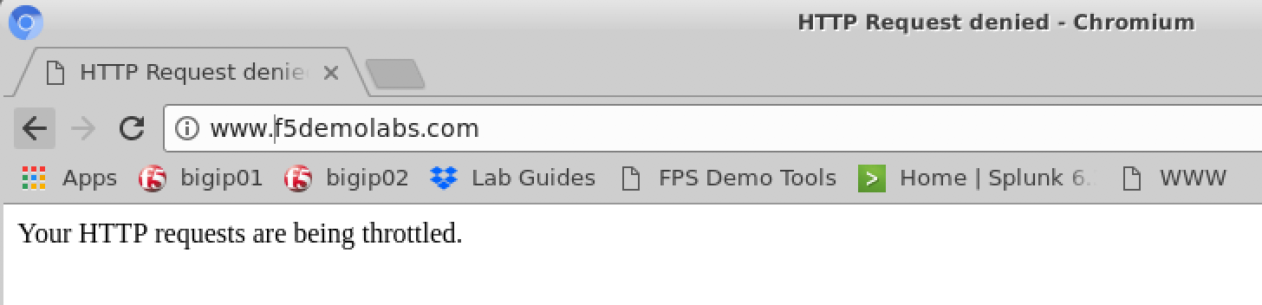
HTTP throttling
when RULE_INIT {
set static::maxReqs 5;
set static::timeout 30;
}
when HTTP_REQUEST {
if { [class match [HTTP::method] equals “POST”] } {
if { [HTTP::header exists X-forwarded-for] } {
set client_IP_addr [getfield [lindex [HTTP::header values X-Forwarded-For] 0] "," 1]
} else {
set client_IP_addr [IP::client_addr]
}
if { not ([class match $client_IP_addr equals whitelist_data_group] )} {
set getcount [table lookup -notouch $client_IP_addr]
if { $getcount equals "" } {
table set $client_IP_addr "1" $static::timeout $static::timeout
} else {
if { $getcount < $static::maxReqs } {
log local0. "Request Count for $client_IP_addr is $getcount"
table incr -notouch $client_IP_addr
} else {
HTTP::respond 403 content {
<html><head><title>HTTP Request denied</title></head><body>Requests throttled</body></html>
}
}
}
}
}
}

Slide 28
Content Rewrite

Slide 29
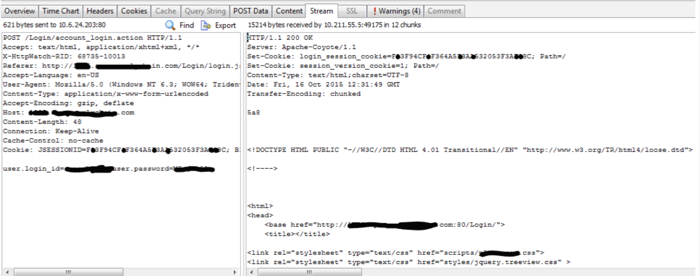
What is wrong with this picture?

Slide 30
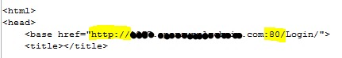
What is wrong with this picture?

Slide 31
Content rewrite
when HTTP_RESPONSE {
# Explicitly disable the stream profile for each request so it doesn’t stay
# enabled for subsequent HTTP requests on the same TCP connection
STREAM::disable
HTTP::header remove “Accept-Encoding”
}
When HTTP_RESPONSE {
# Apply stream profile against text responses from the application
if { [HTTP::header value Content-Type] contains "text"} {
# Look for http:// and replace it with https://
STREAM::expression “@http://@https://@”
# Enable the stream profile
STREAM::enable
}
}

Slide 32
Content rewrite
when HTTP_RESPONSE {
# Explicitly disable the stream profile for each request so it doesn’t stay
# enabled for subsequent HTTP requests on the same TCP connection
STREAM::disable
HTTP::header remove “Accept-Encoding”
}
When HTTP_RESPONSE {
# Apply stream profile against text responses from the application
if { [HTTP::header value Content-Type] contains "text"} {
# Look for http:// and replace it with https://
STREAM::expression “@http://@https://@”
# Enable the stream profile
STREAM::enable
}
}
STREAM::expression “@\d3-\d2-\d4@***-**-****@ @\d4-\d4-\d4-\d4@xxxx-xxxx-xxxx-xxxx@”

Slide 33
Content rewrite Open a new browser tab
Devcentral member Asks:
Just wonder is that possible when user click the web site link and F5 will assist to open a new tab for new page instead ?
Example : when user access to www.test.com and click on the "contact" button link . Then, f5 will assist open a new tab.

Slide 34
Content rewrite Open a new browser tab
Devcentral member Asks:
Just wonder is that possible when user click the web site link and F5 will assist to open a new tab for new page instead ?
Example : when user access to www.test.com and click on the "contact" button link . Then, f5 will assist open a new tab .
Another Devcentral member responds:
this would be possible using a STREAM Profile or by using an iRule using the [STREAM::enable], [STREAM::disable] and [STREAM::expression] syntax. Basically you have to change the "contact" button related HTML content so that it instructs the browser to open the link in a new Window/Tab.
If the original code looks like this...
<a href="http://www.test.com/contact.html">Contact</a>
... it has to be changed to ...
<a href="http://www.test.com/contact.html" target="_blank">Contact</a>
The STREAM expression would then look like this...
@www.test.com/contact.html\">@www.test.com/contact.html\" target=\"_blank\">@
- Kai Wilkie, member devcentral.f5.com

Slide 35
HSTS / HPKP

Slide 36
What is HSTS / HPKP?
HTTP Strict Transport Security (per OWASP and RFC 6797)
An opt-in security enhancement that is specified by a web application through the use of a special response header. Once a supported browser receives this header that browser will prevent any communications from being sent over HTTP to the specified domain and will instead send all communications over HTTPS. It also prevents HTTPS click through prompts on browsers.
Strict-Transport-Security: max-age=31536000; includeSubDomains
Header name
1 year
Optional: include all subdomains

Slide 37
What is HSTS / HPKP?
HTTP Strict Transport Security (per OWASP and RFC 6797)
An opt-in security enhancement that is specified by a web application through the use of a special response header. Once a supported browser receives this header that browser will prevent any communications from being sent over HTTP to the specified domain and will instead send all communications over HTTPS. It also prevents HTTPS click through prompts on browsers.
Strict-Transport-Security: max-age=31536000; includeSubDomains
HTTP Public Key Pinning (per OWASP and RFC 7469 and also referred to as “HTTP Pinning”)
A new HTTP header that allows SSL servers to declare hashes of their certificates with time scope in which these certificates should not be changed.
Public-Key-Pins: max-age=2592000;
pin-sha256="E9CZ9INDbd+2eRQozYqqbQ2yXLVKB9+xcprMF+44U1g=";
pin-sha256="LPJNul+wow4m6DsqxbninhsWHlwfp0JecwQzYpOLmCQ=";
report-uri="http://example.com/pkp-report"
Header name
1 year
Optional: include all subdomains

Slide 38
HSTS / HPKP
when RULE_INIT {
set static::fqdn_pin1 "X3pGTSOuJeEVw989IJ/cEtXUEmy52zs1TZQrU06KUKg=”
# Set max_age to 180 days
set static::max_age 15552000
}
when HTTP_RESPONSE {
# Insert an HSTS header
HTTP::header insert Strict-Transport-Security "max-age=$static::max_age; includeSubDomains”
# Insert an HPKP header
HTTP::header insert Public-Key-Pins "pin-sha256=\"$static::fqdn_pin1\" max-age=$static::max_age; includeSubDomains”
}

Slide 39
HSTS / HPKP
when RULE_INIT {
set static::fqdn_pin1 "X3pGTSOuJeEVw989IJ/cEtXUEmy52zs1TZQrU06KUKg=”
# Set max_age to 180 days
set static::max_age 15552000
}
when HTTP_RESPONSE {
# Insert an HSTS header
HTTP::header insert Strict-Transport-Security "max-age=$static::max_age; includeSubDomains”
# Insert an HPKP header
HTTP::header insert Public-Key-Pins "pin-sha256=\"$static::fqdn_pin1\" max-age=$static::max_age; includeSubDomains”
}
openssl x509 -in <cert> -pubkey -noout |openssl rsa -pubin -outform der |openssl dgst -sha256 -binary |openssl enc -base64

Slide 40
HSTS / HPKP
when RULE_INIT {
set static::fqdn_pin1 "X3pGTSOuJeEVw989IJ/cEtXUEmy52zs1TZQrU06KUKg=”
# Set max_age to 180 days
set static::max_age 15552000
}
when HTTP_RESPONSE {
# Insert an HSTS header
HTTP::header insert Strict-Transport-Security "max-age=$static::max_age; includeSubDomains”
# Insert an HPKP header
HTTP::header insert Public-Key-Pins "pin-sha256=\"$static::fqdn_pin1\" max-age=$static::max_age; includeSubDomains”
}
Always insert the HTTP header in an HTTPS response

Slide 41
HSTS / HPKP
when RULE_INIT {
set static::fqdn_pin1 "X3pGTSOuJeEVw989IJ/cEtXUEmy52zs1TZQrU06KUKg=”
# Set max_age to 180 days
set static::max_age 15552000
}
when HTTP_RESPONSE {
# Insert an HSTS header
HTTP::header insert Strict-Transport-Security "max-age=$static::max_age; includeSubDomains”
# Insert an HPKP header
HTTP::header insert Public-Key-Pins "pin-sha256=\"$static::fqdn_pin1\" max-age=$static::max_age; includeSubDomains”
}
user types: www.google.com
browser requests: https://www.google.com

Slide 42
Secure your cookies

Slide 43
Secure your cookies
Cookies not marked secure by application
No HttpOnly flag
Failing an audit?
Vulnerable to XSS attack?
when HTTP_RESPONSE {
set ckname “mycookie"
if { [HTTP::cookie exists $ckanme } {
HTTP::cookie secure $ckname enable
HTTP::cookie httponly $ckname enable
}
}
A secure cookie can only be transmitted over an encrypted connection (i.e. HTTPS).
HttpOnly cookies can only be used when transmitted via HTTP (or HTTPS). They are not accessible through non-HTTP APIs such as JavaScript. This restriction eliminates the threat of cookie theft via cross-site scripting (XSS)

Slide 44
F5 DNS Hooks

Slide 45
Geolocation + L7DoS hooks

Slide 46
Geolocation
when HTTP_REQUEST {
set XFF [getfield [lindex [HTTP::header values X-Forwarded-For] 0] “,” 1]
log local0. “continent: [whereis ${XFF} continent]”
log local0. “country: [whereis ${XFF} country]”
log local0. “state: [whereis ${XFF} state]”
log local0. “isp: [whereis ${XFF} isp]”
log local0. “org: [whereis ${XFF} org]”
}
[whereis [IP::client_addr] continent] – returns the continent
[whereis [IP::client_addr] country] – returns the continent
[whereis [IP::client_addr] <state|abbrev>] – returns the state information as word or as two-letter abbreviation
[whereis [IP::client_addr] isp] – returns the carrier
[whereis [IP::client_addr] org] - returns the registered organization

Slide 47
Geolocation
when HTTP_REQUEST {
set XFF [getfield [lindex [HTTP::header values X-Forwarded-For] 0] ”,” 1]
if { [whereis ${XFF} country] ne “US” } {
drop
event disable all
}
}
when HTTP_REQUEST {
set XFF [getfield [lindex [HTTP::header values X-Forwarded-For] “,” 1]
if { not ( [class match [whereis ${XFF} country] equals list_of_countries ] )} {
#log local0. “[whereis ${XFF} country] is not a part of accepted countries, traffic is dropped”
drop
event disable all
}
}
ltm data-group internal list_of_countries {
type string
records {
US {}
CA {}
IN {}
LB {}
}
}

Slide 48
Geolocation
when HTTP_REQUEST {
set XFF [getfield [lindex [HTTP::header values X-Forwarded-For] 0] ”,” 1]
if { [whereis ${XFF} country] ne “US” } {
drop
event disable all
}
}
when HTTP_REQUEST {
set XFF [getfield [lindex [HTTP::header values X-Forwarded-For] “,” 1]
if { not ( [class match [whereis ${XFF} country] equals list_of_countries ] )} {
#log local0. “[whereis ${XFF} country] is not a part of accepted countries, traffic is dropped”
drop
event disable all
}
}
ltm data-group internal list_of_countries {
type string
records {
US {}
CA {}
IN {}
LB {}
}
}

Slide 49
L7DOS - BOTDEFENSE
when BOTDEFENSE_ACTION {
# triggered immediately prior to botdefense feature taking an action
log local0. " Geolocation Country: [whereis $XFF country] "
log local0. " Bot Defense Status: [BOTDEFENSE::reason] "
log local0. " Bot Defense Action: [BOTDEFENSE::action] ”
log local0. ” Bot Defense Bot Sig: [BOTDEFENSE::bot_signature] “
log local0. “ Bot Defense Device ID: [BOTDEFENSE::device_id] “
}
[BOTDEFENSE::action ] – allows for set or override of action, sample options include: allow, browser_challenge, tcp_rst,redirect_with_cookie, custom_response,
BOTDEFENSE::enable – enables processing and blocking of the request by Bot Defense
BOTDEFENSE::disable – disables processing and blocking of the request by Bot Defense
BOTDEFENSE::previous_action – returns action taken by previous request, applicable if current request is a follow-up to challenge
BOTDEFENSE::support_id - returns the support ID of the request

Slide 50
Geolocation + L7DoS Combining Context
When HTTP_REQUEST {
# Checks value of inbound XFF against geolocation database, then take action
if {!([whereis $XFF country] equals "RU")} {
log local0. "De-activating PBD: Not Russia source"
# disables BOTDEFENSE for all bot requests originating from Russia
BOTDEFENSE::disable
}
}

Slide 51
Client Certificate Inspection

Slide 52
Client Certificate Inspection
when RULE_INIT {
set static::debug 1
}
when CLIENTSSL_CLIENTCERT {
# Example Subject DN: /C=AU/ST=NSW/L=Syd/O=Your Organization/OU=Your OU/CN=John Smith
set subject_dn [X509::subject [SSL::cert 0]]
if { $subject_dn != "" } {
if { $static::debug }{ log "Client Certificate received: $subject_dn” }
}
}
when HTTP_REQUEST {
if { [HTTP::uri] starts_with "/" } {
if { $subject_dn contains "CN=Whitfield Diffe" } {
HTTP::uri /whitfielddiffe/index.html
} elseif { $subject_dn contains “CN=Martin Hellman” } {
HTTP::uri /martinhellman/index.html
} {
reject
}
}
}

Slide 53
Client Certificate Inspection
when RULE_INIT {
set static::debug 1
}
when CLIENTSSL_CLIENTCERT {
# Example Subject DN: /C=AU/ST=NSW/L=Syd/O=Your Organisation/OU=Your OU/CN=John Smith
set subject_dn [X509::subject [SSL::cert 0]]
if { $subject_dn != "" } {
if { $static::debug }{ log "Client Certificate received: $subject_dn” }
}
}
when HTTP_REQUEST {
if { [HTTP::uri] starts_with "/" } {
if { $subject_dn contains "CN=Whitfield Diffe" } {
HTTP::uri /whitfielddiffe/index.html
} elseif { $subject_dn contains “CN=Martin Hellman” } {
HTTP::uri /martinhellman/index.html
} {
reject
}
}
}

Slide 54
Client Certificate Inspection
Services
John Smith
Services
Policy Services
Services
when RULE_INIT {
set static::debug 1
}
when CLIENTSSL_CLIENTCERT {
# Example Subject DN: /C=AU/ST=NSW/L=Syd/O=Your Organization/OU=Your OU/CN=John Smith
set subject_dn [X509::subject [SSL::cert 0]]
if { $subject_dn != "" } {
if { $static::debug }{ log "Client Certificate received: $subject_dn” }
}
}
when HTTP_REQUEST {
if { [HTTP::uri] starts_with "/" } {
if { $subject_dn contains "CN=Whitfield Diffe" } {
HTTP::uri /whitfielddiffe/index.html
} elseif { $subject_dn contains “CN=Martin Hellman” } {
HTTP::uri /martinhellman/index.html
} {
reject
}
}
}

Slide 55
IP Reputation

Slide 56
IP Reputation
when HTTP_REQUEST {
# Use [HTTP::header values "X-Forwarded-For"] in replacement of [IP::client_addr] if using the x-forwarded-for
# for testing
# set iprep_categories [IP::reputation [IP::client_addr]]
set iprep categories [IP::reputation [HTTP::header values “X-Forwarded-For]]
set is_reject 0
if { $iprep_categories contains "Windows Exploits" } {
set is_reject 1
}
if { $iprep_categories contains "Web Attacks" } {
set is_reject 1
}
if { $iprep_categories contains "Scanners" } {
set is_reject 1
}
if { $iprep_categories contains "Proxy" } {
set is_reject 1
}
if { $is_reject } {
log local0. "Attempted access from malicious IP address [HTTP::header values “X-Forwarded-For]($iprep_categories) - rejected"
HTTP::respond 200 content "<HTML><HEAD><TITLE>Rejected Request</TITLE></HEAD>
<BODY>The request was rejected. <BR>Attempted access from malicious IP address</BODY>
</HTML>”
}
}

Slide 57
IP Reputation
when HTTP_REQUEST {
# Use [HTTP::header values "X-Forwarded-For"] in replacement of [IP::client_addr] if using the x-forwarded-for
# for testing
# set iprep_categories [IP::reputation [IP::client_addr]]
set iprep_categories [IP::reputation [HTTP::header values “X-Forwarded-For]]
set is_reject 0
if { $iprep_categories contains "Windows Exploits" } {
set is_reject 1
}
if { $iprep_categories contains "Web Attacks" } {
set is_reject 1
}
if { $iprep_categories contains "Scanners" } {
set is_reject 1
}
if { $iprep_categories contains "Proxy" } {
set is_reject 1
}
if { $is_reject } {
log local0. "Attempted access from malicious IP address [IP::client_addr]($iprep_categories) - rejected"
HTTP::respond 200 content "<HTML><HEAD><TITLE>Rejected Request</TITLE></HEAD>
<BODY>The request was rejected. <BR>Attempted access from malicious IP address</BODY>
</HTML>”
}
}

Slide 58
IP Reputation
when HTTP_REQUEST {
# Use [HTTP::header values "X-Forwarded-For"] in replacement of [IP::client_addr] if using the x-forwarded-for
# for testing
# set iprep_categories [IP::reputation [IP::client_addr]]
set iprep_categories [IP::reputation [HTTP::header values “X-Forwarded-For]]
set is_reject 0
if { $iprep_categories contains "Windows Exploits" } {
set is_reject 1
}
if { $iprep_categories contains "Web Attacks" } {
set is_reject 1
}
if { $iprep_categories contains "Scanners" } {
set is_reject 1
}
if { $iprep_categories contains "Proxy" } {
set is_reject 1
}
if { $is_reject } {
log local0. "Attempted access from malicious IP address [IP::client_addr]($iprep_categories) - rejected"
HTTP::respond 200 content "<HTML><HEAD><TITLE>Rejected Request</TITLE></HEAD>
<BODY>The request was rejected. <BR>Attempted access from malicious IP address</BODY>
</HTML>”
}
}

Slide 59
IP Reputation
when HTTP_REQUEST {
# Use [HTTP::header values "X-Forwarded-For"] in replacement of [IP::client_addr] if using the x-forwarded-for
# for testing
# set iprep_categories [IP::reputation [IP::client_addr]]
set iprep_categories [IP::reputation [HTTP::header values “X-Forwarded-For]]
set is_reject 0
if { $iprep_categories contains "Windows Exploits" } {
set is_reject 1
}
if { $iprep_categories contains "Web Attacks" } {
set is_reject 1
}
if { $iprep_categories contains "Scanners" } {
set is_reject 1
}
if { $iprep_categories contains "Proxy" } {
set is_reject 1
}
if { $is_reject } {
log local0. "Attempted access from malicious IP address [IP::client_addr]($iprep_categories) - rejected"
HTTP::respond 200 content "<HTML><HEAD><TITLE>Rejected Request</TITLE></HEAD>
<BODY>The request was rejected. <BR>Attempted access from malicious IP address</BODY>
</HTML>”
}
}

Slide 60
Thank You

